Slide 1
Business Process Engineering
Process Redesign
Lecture: 11

Slide 2

Process Redesign

Slide 3
Process Redesign
Identify possibilities for improving the design of a process
No silver-bullet: requires creativity
Redesign heuristics can be used to generate ideas
AS-IS: Descriprive modelling
of the real world
TO-BE: Prescriptive modelling
of the real world

Slide 4
Process redesign approaches
Transactional
Transformational
Puts into question the fundamental assumptions and principles of the existing process structure
Doesn’t put into question the current process structure
Seeks to identify problems and resolve them incrementally, one step at a time
Example: Heuristic redesign (next week)
Aims to achieve breakthrough innovation
Example: Business Process Reengineering (BPR)
Notes:
Aims to achieve breakthrough innovation, for example by removing costly tasks that do not directly add value

Slide 5
Business Process Reengineering (BPR)
Transformative: Puts into question the fundamental assumptions of the “as is” process
Analytical: Based on a set of principles that foster:
Outcome-driven processes
Integration of information gathering, work and decisions

Slide 6
The Ford Case Study
Ford needed to review its procurement process to:
Do it cheaper (cut costs)
Do it faster (reduce turnaround times)
Do it better (reduce error rates)
Accounts payable in North America alone employed > 500 people and turnaround times for processing POs and invoices was in the order of weeks
(Hammer, 1990)
Notes:
Hammer, M., (1990). "Reengineering Work: Don't Automate, Obliterate", Harvard Business Review, July/August, pp. 104–112.

Slide 7
The Ford Case Study
Automation would bring some improvement (20% improvement)
But Ford decided not to do it… Why?
Because at the time, the technology needed to automate the process was not yet available.
Because nobody at Ford knew how to develop the technology needed to automate the process.
Because there were not enough computers and computer-literate employees at Ford.
None of the above

Slide 8
The correct answer is …
Mazda’s Payable Department!

Slide 9
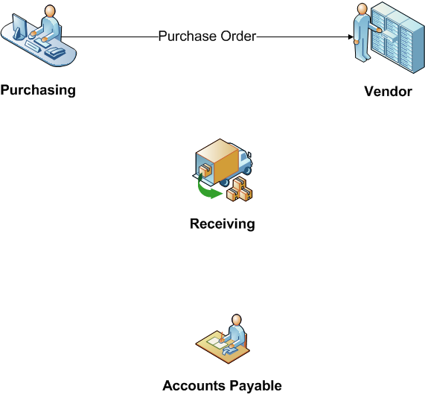
How the process worked? (“as is”)

Slide 10
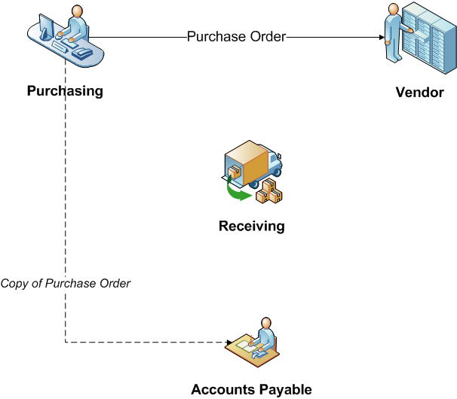
How the process worked? (“as is”)

Slide 11
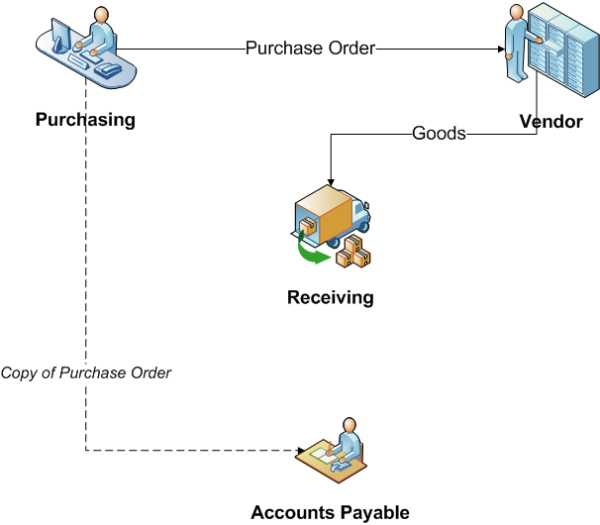
How the process worked? (“as is”)

Slide 12
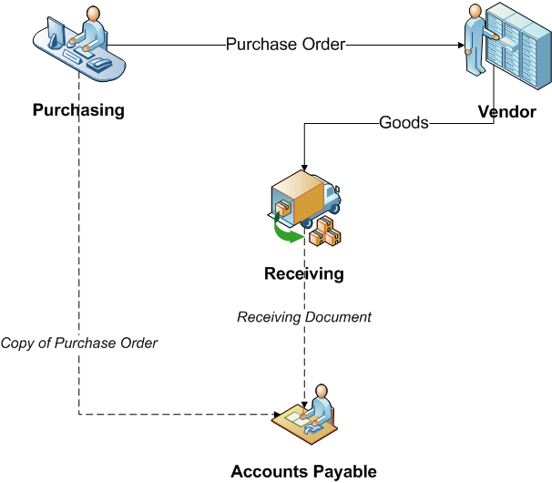
How the process worked? (“as is”)

Slide 13
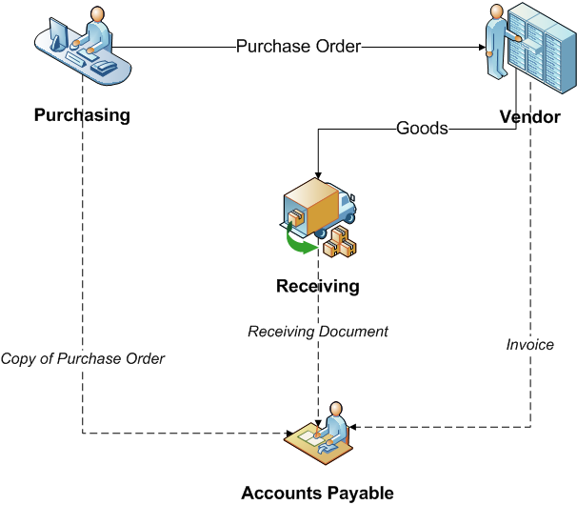
How the process worked? (“as is”)

Slide 14
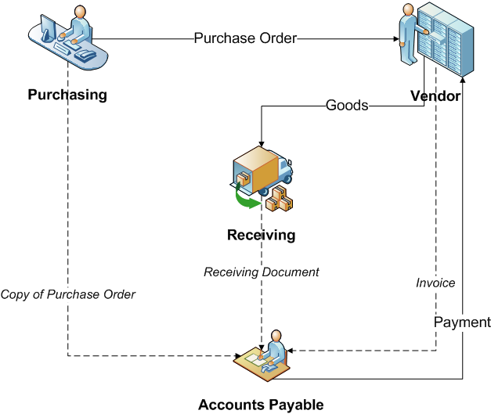
How the process worked? (“as is”)

Slide 15
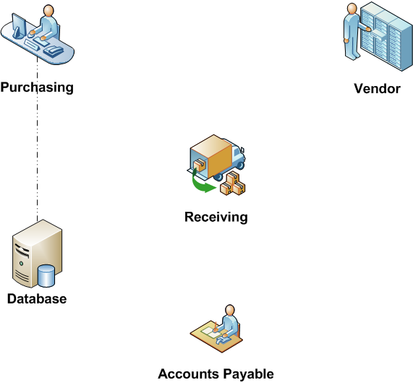
Reengineered Process (“to be”)

Slide 16
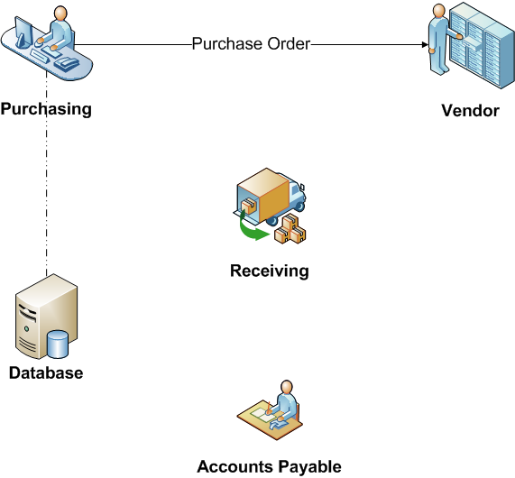
Reengineered Process (“to be”)

Slide 17
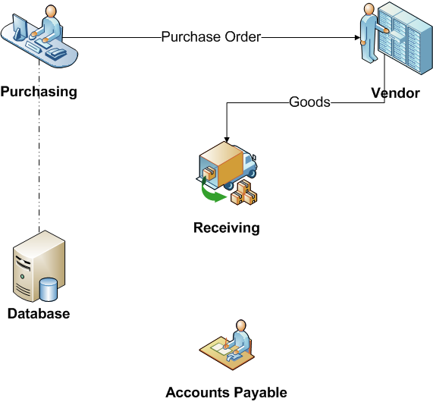
Reengineered Process (“to be”)

Slide 18
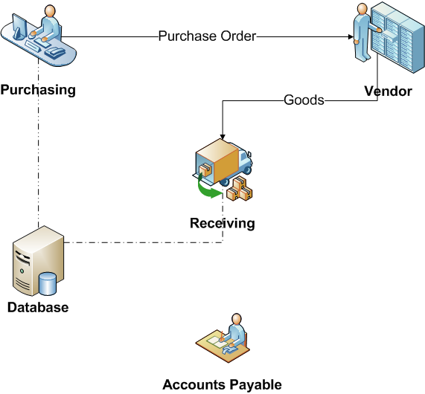
Reengineered Process (“to be”)

Slide 19

Reengineered Process (“to be”)

Slide 20
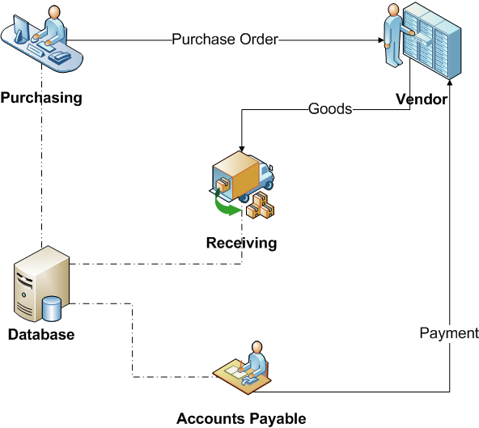
Reengineered Process (“to be”)
Evaluated Receipts Settlement

Slide 21
Outcome…
75% reduction in head count
Simpler material control
More accurate financial information
Faster purchase requisition
Less overdue payments
Lessons:
Why automate something we don’t need to do at all?
Automate things that need to be done.
“Don’t Automate, Obliterate!” (Hammer, 1990)

Slide 22
Some principles of BPR
Capture information once and at the source
Subsume information-processing work into the real work that produces the information
Have those who use the output of the process drive the process
Put the decision point where the work is performed, and build control into the process
Treat geographically dispersed resources as though they were centralized.
Notes:
Regarding the first principle, it is worth citing examples of process improvement patterns such as Self-Service and Vendor-Managed Inventory Control.
Regarding, the second principle, self-service is again a typical example, particularly the ability for customers or workers to enter data themselves that goes directly into the organization’s databases
Regarding the third principle, we can refer back to the idea of performing PO matching at delivery, rather than postponing this till the invoice is received

Slide 23
Principle 1
Capture information once and at the source
Shared data store
All process workers access the same data
Don’t send around data, share it!
Self-service
Customers capture data themselves
Customers perform tasks themselves (e.g. collect documents)

Slide 24
Principle 2
Subsume information-processing work into the real work
Evaluated receipt settlement: when receiving the products, record the fulfillment of the PO, which triggers payment

Slide 25
Principle 3
Have those who use the output of the process drive the process
Vendor-managed inventory
Scan-based trading
Push work to the actor that has the incentive to do it

Slide 26
Example: Problematic claims process
Authorize
Pay
Client
Claim
Insurer
Request quote
Approved
glass
vendor
Pay

Slide 27
Redesigned claims process
Client
Insurer
Claim
Pay
Approved
glass
vendor
Drop

Slide 28
Principle 4
Put the decision point where the work is performed, and build control into the process
Empower the process workers
Provide process workers with information needed to make decisions themselves
Replace back-and-forth handovers between workers and managers (transportation waste) with well-designed controls

Slide 29
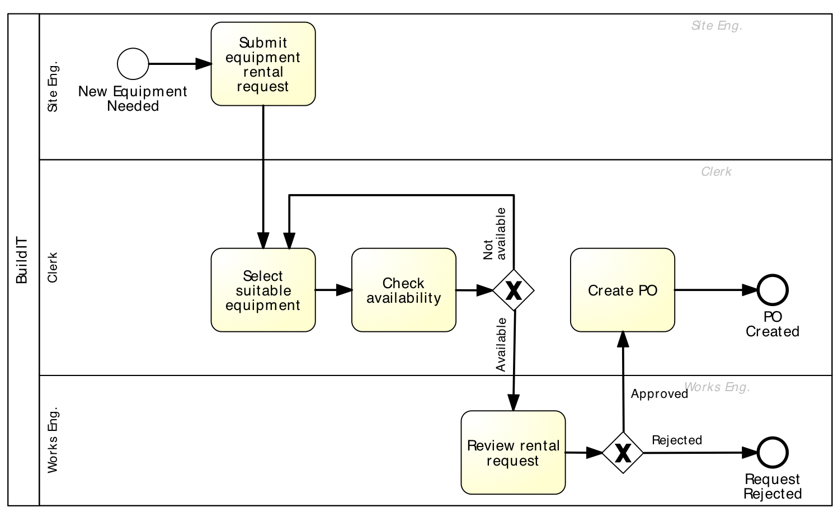
Equipment rental process

Slide 30
Self-service-based redesign
Principles 1 & 2
When equipment is needed, site engineer queries the suppliers’ catalogue, selects equipment and triggers PO
Principle 3
Supplier stocks frequently used equipment at construction site, site engineers scan to put them into use
Principle 4
Site engineer is empowered with the authority to rent the equipment; works engineer performs statistical controls

Slide 31
Principle 5
Treat geographically dispersed resources as though they were centralized.
If same people perform the same function in different locations, integrate and share their work wherever possible
Larger resource pools → less waiting times even with relatively high resource utilization

Slide 32
Chapter 8
Fundamentals of Business Process Management
Marlon Dumas, Marcello La Rosa, Jan Mendling, Hajo A. Reijers
Springer 2018

